Slide 1
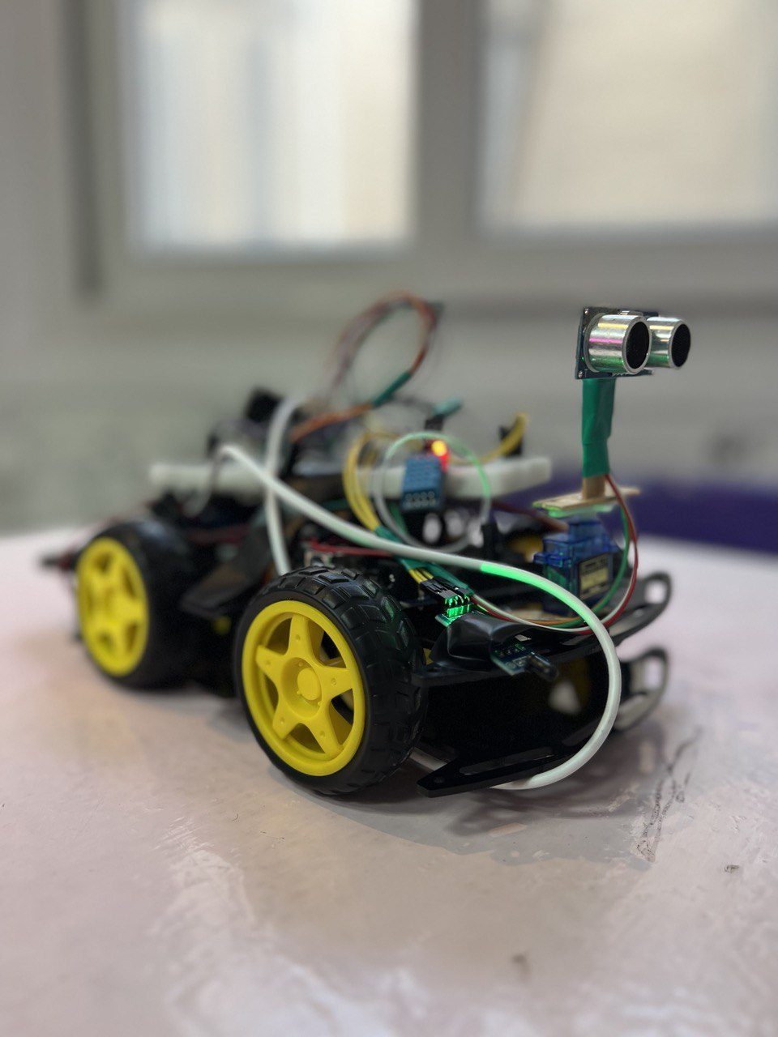
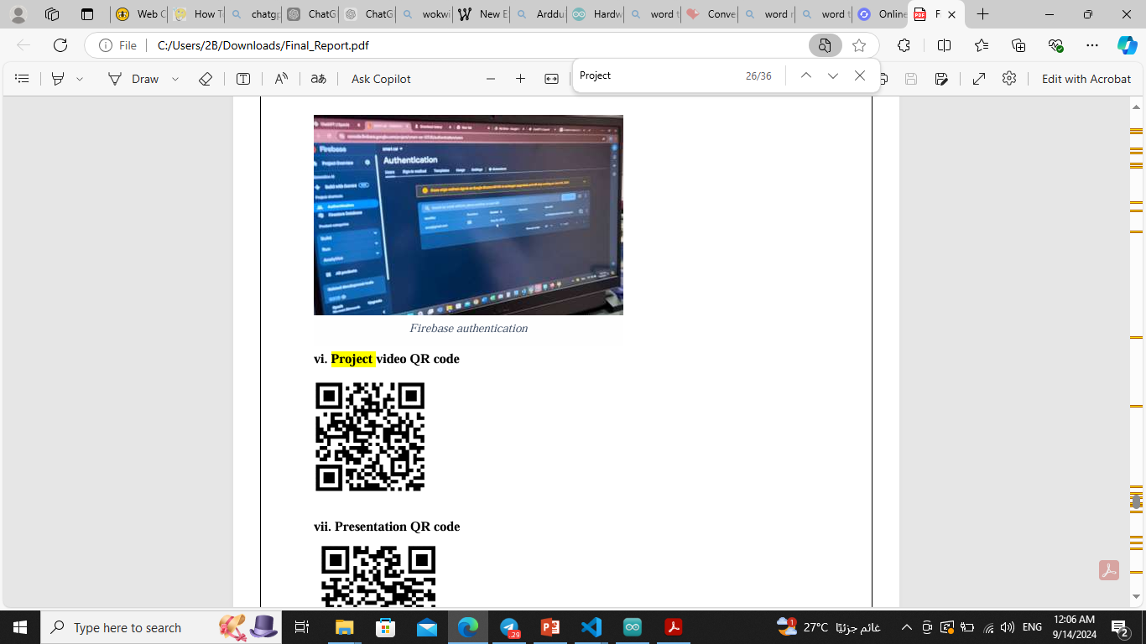
SMART CAR
AZZA

Slide 2
About Us
We are a dedicated team of engineering students from the Faculty of Computer and Data Science at Alexandria University.
This project is part of our Field Training 1, where we applied practical skills to develop a smart car system with sensor integration and cloud connectivity.

Slide 3
About Us
Name | ID | Task
Marwan Mahmoud | 22010250 | Arduino uno-Wiring-Esp32
Kenzy Abd El Kereem | 22010379 | Arduino uno-Wiring-Esp32
Shahd Ahmed Mohamed | 22010118 | Arduino uno-Wiring-Esp32
Mona Adel Atteya | 22010271 | MQTT Broker-Powerpoint
Rawan Abdo Ahmed | 22010094 | Flutter app-Firebase
Mahmoud Ahmed | 22010236 | Flutter app

Slide 4
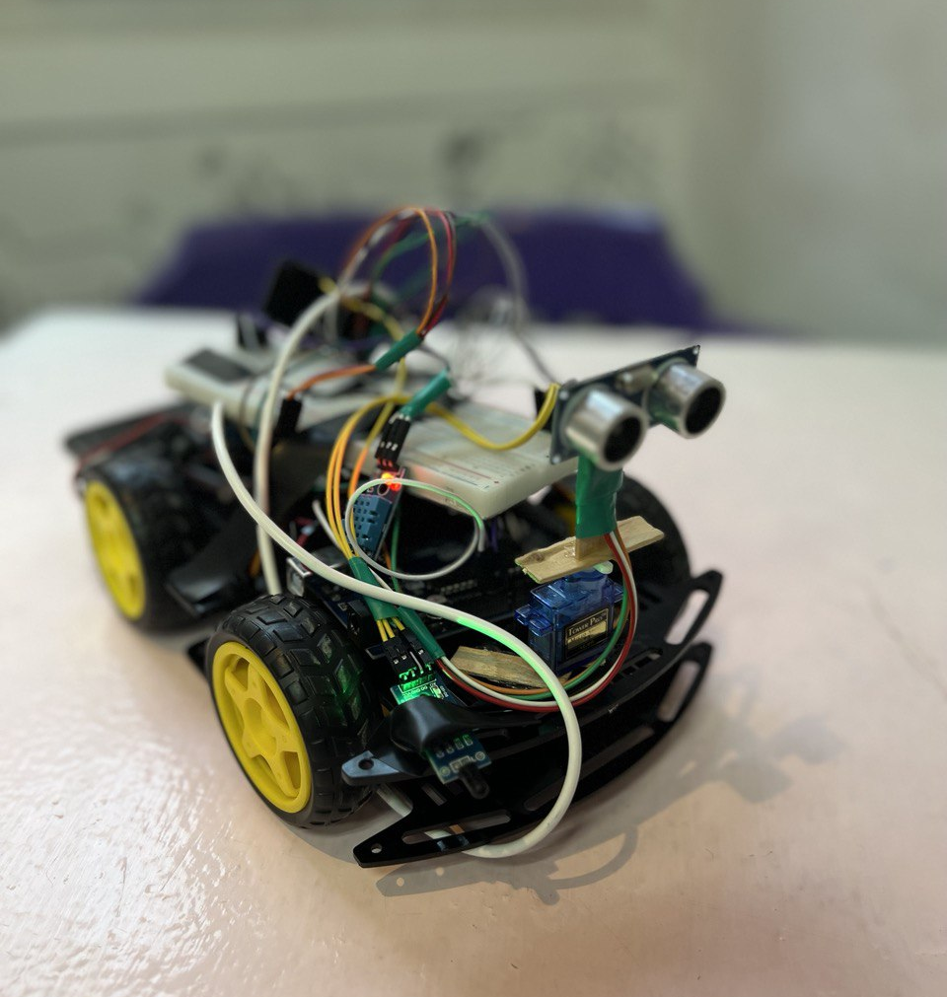
Agenda
Project Overview
Technology Stack
System Architecture
Code Implementation
MOTT Integration
Flutter App Interface
References
Acknowledgment

Slide 5
Project Overview
Azza is an advanced smart car project designed to enhance safety and functionality using a combination of sensors and IoT technologies. The car integrates an Arduino Uno and an ESP32 microcontroller to manage and process data from various sensors, ensuring optimal performance and reliability.
The project aims to create an autonomous vehicle capable of avoiding collisions, detecting fire and movement, and providing real-time feedback through a user-friendly Flutter application. By leveraging a suite of sensors, including ultrasonic, flame, and infrared, along with a buzzer and LCD display, Azza represents a significant step forward in smart vehicle technology.

Slide 6
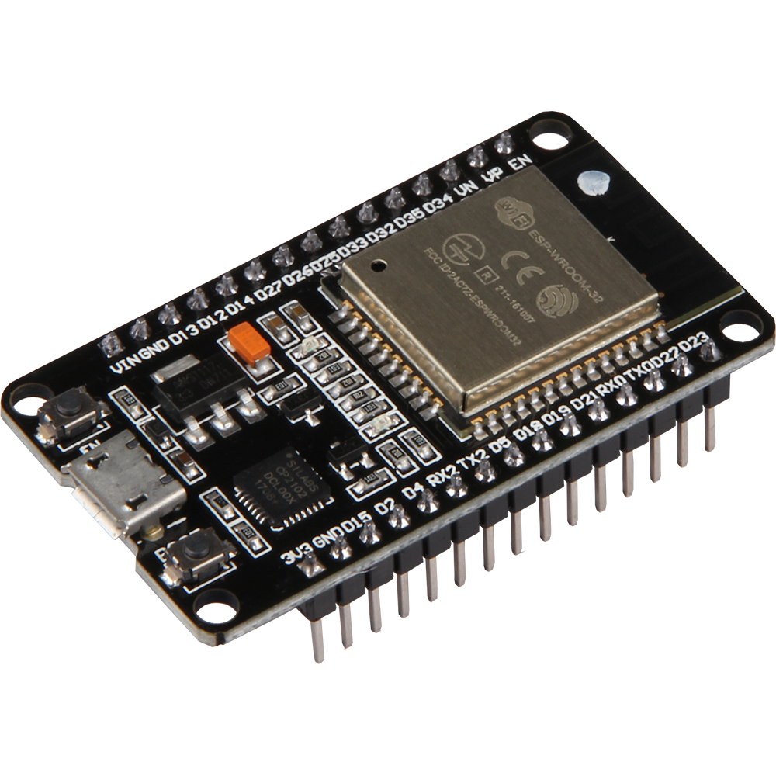
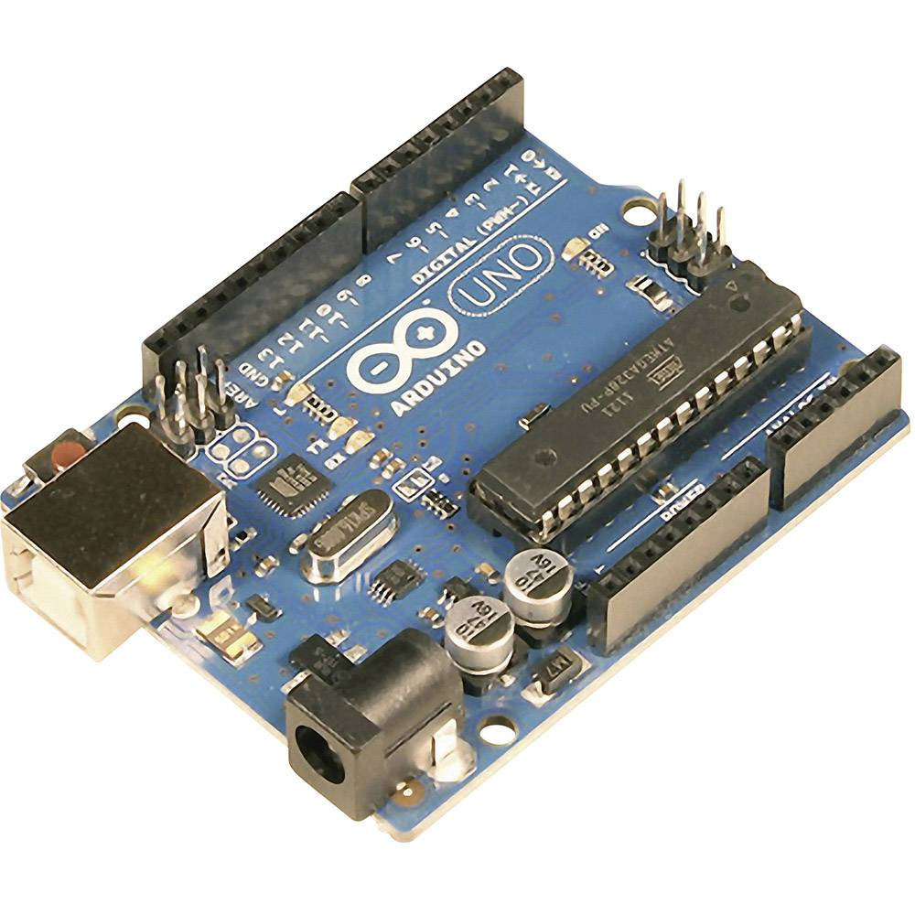
Technology Stack
I. Hardware
Microcontrollers:
Arduino Uno
Esp32

Slide 7
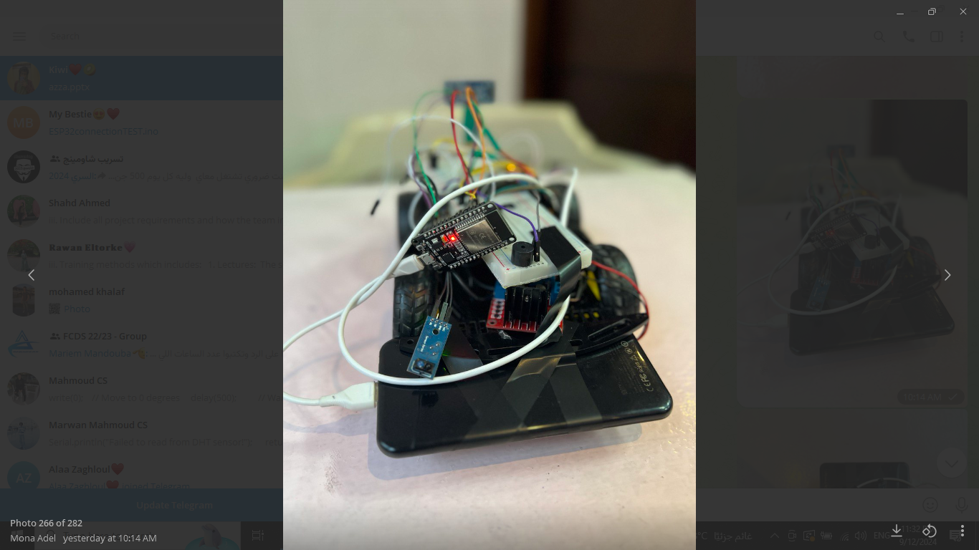
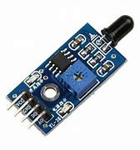
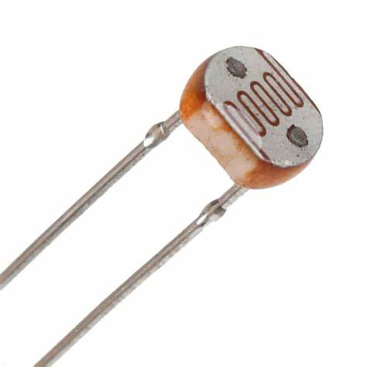
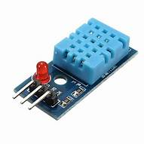
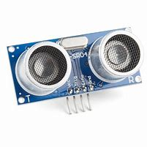
Technology Stack
Sensors:
IR sensor
Flame sensor
DHT11 sensor
Ultrasonic sensor
LDR sensor

Slide 8
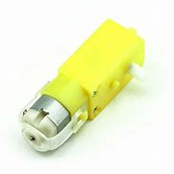
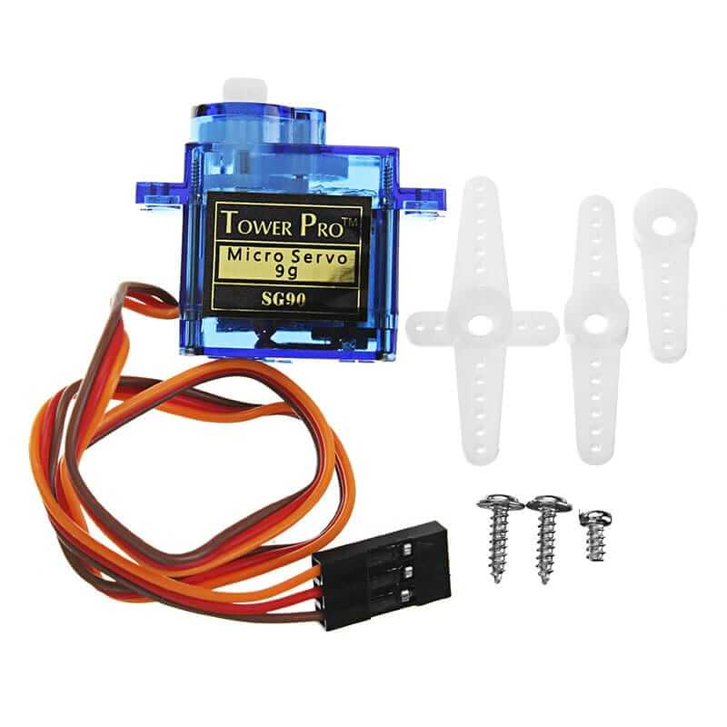
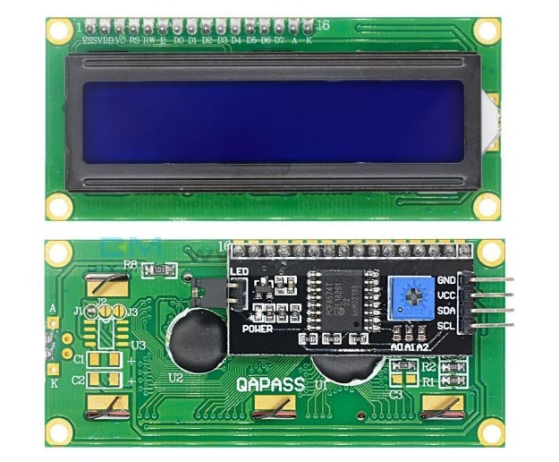
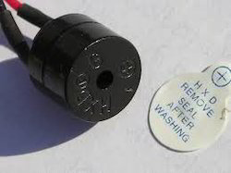
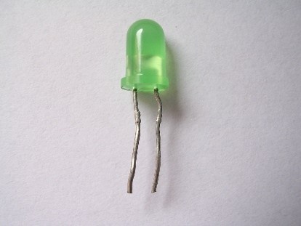
Technology Stack
Actuators and Indicators:
DC motors
Servo motor
Buzzer
LED
LCD

Slide 9
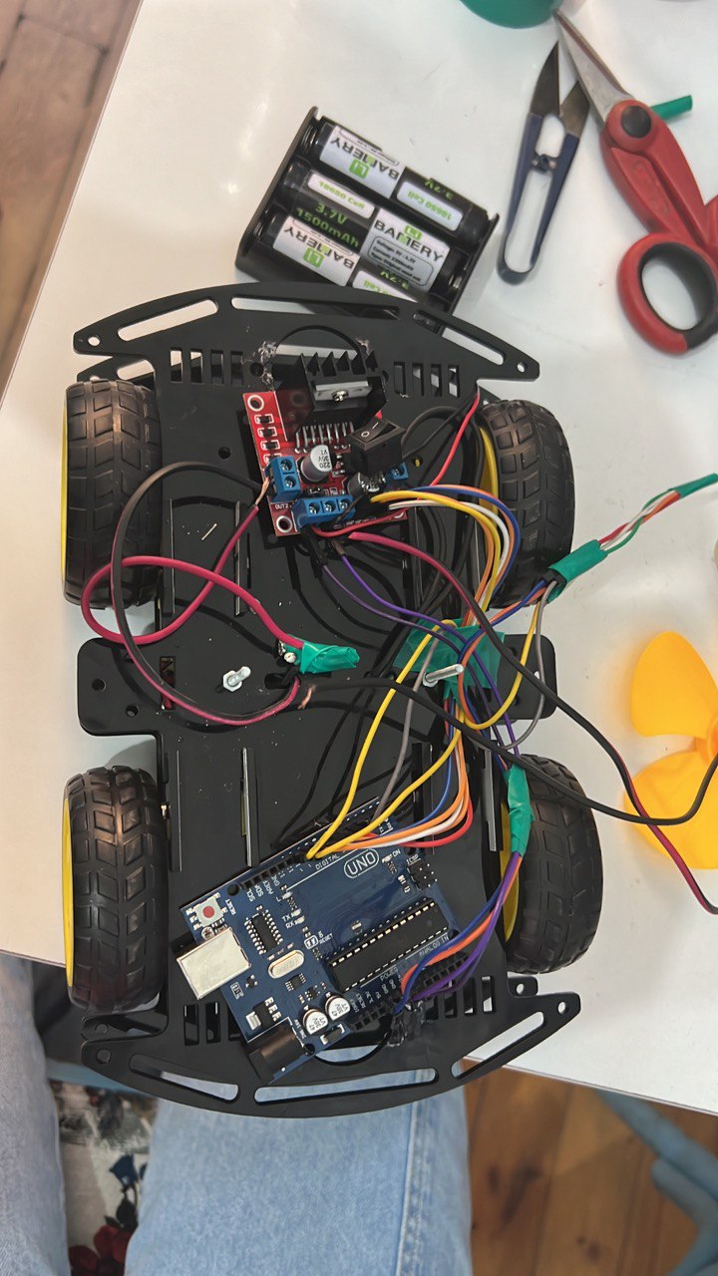
Technology Stack
Driver and Controller:
L298N driver

Slide 10





Technology Stack
Platforms
Arduino IDE
PlatformIO
HiveMQ
Flutter
Firebase

Slide 11
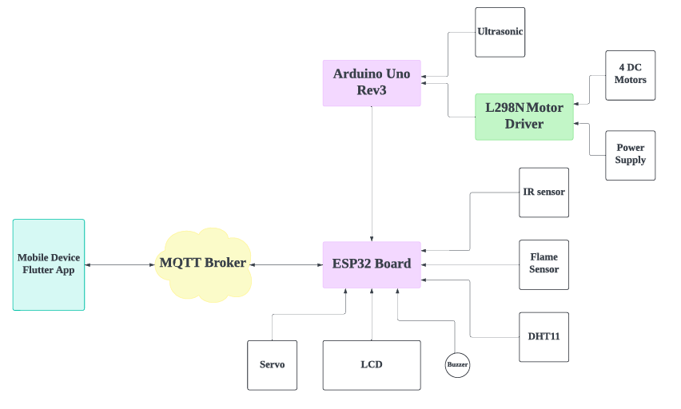
Technology Stack
Data Flow & Connections

Slide 12
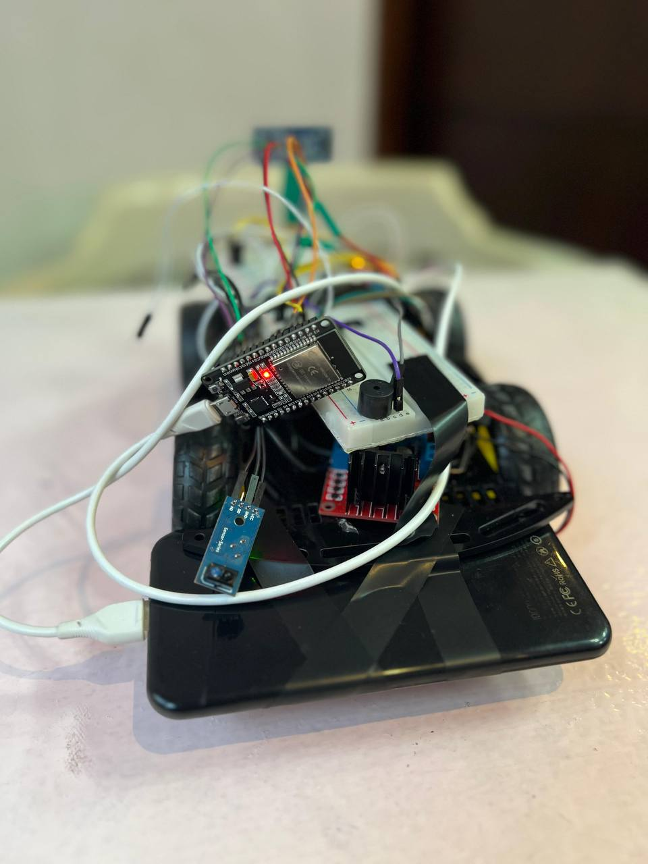
We connect to the ESP32
(IR , Flame , DHT11 , Buzzer and Servo motor )
DHT11 to measure temperature and humidity

Slide 13
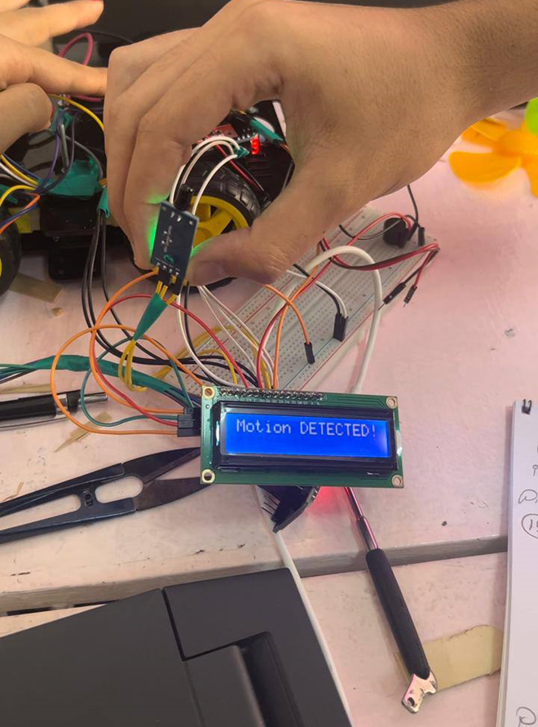
IR sensor to detect movement and used LCD to display the reading.
Flame sensor to detect any fire and display it on the LCD.
LDR sensitive to light and the LED reacts to it

Slide 14
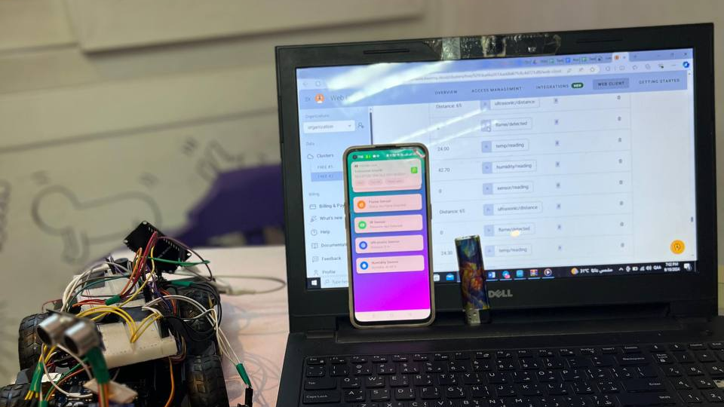
We connected the Arduino Uno to the ESP32.
The Arduino sends the ultrasonic distance reading to the ESP32.
The MQTT broker receives sensor data from ESP32.(Data is published and accessible for external applications)
The MQTT sends this data to the Flutter application.
The Flutter app receives and displays sensor data via MQTT.
The connection between Arduino and ESP is confirmed.

Slide 15
Code Implementation
ARDUINO UNO
Flutter Application
ESP32&
MQTT

Slide 16
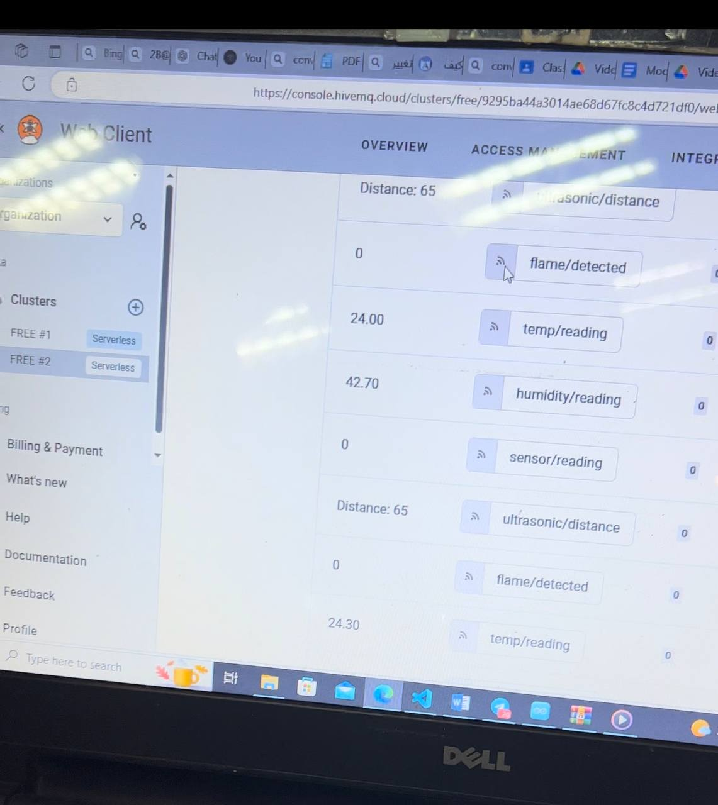
MQTT Integration

Slide 17
Why MQTT?
Specifically designed for the IoT and comes with an array of features that cater to IoT scenarios. It facilitates stable and reliable device communication and real time data transfer.

Slide 18
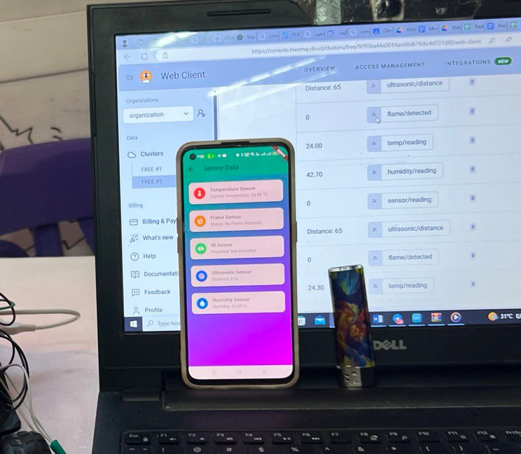
MQTT Purpose In Azza:
1. Receives sensor data from the ESP32.
2. Controls the LED by subscribing to (led/control).
3. Intermediate between ESP32 & Flutter app allowing the mobile application to monitor real time sensor data

Slide 19
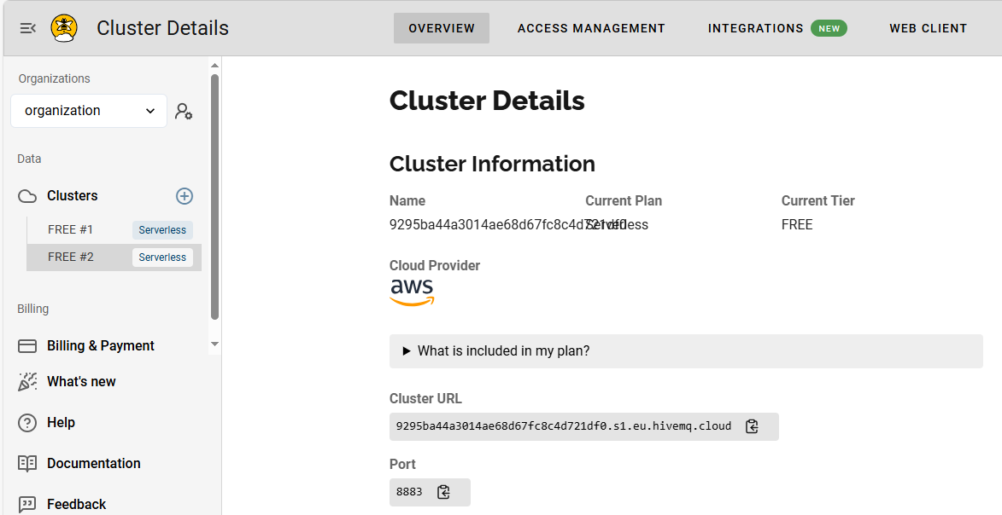
MQTT Details

Slide 20
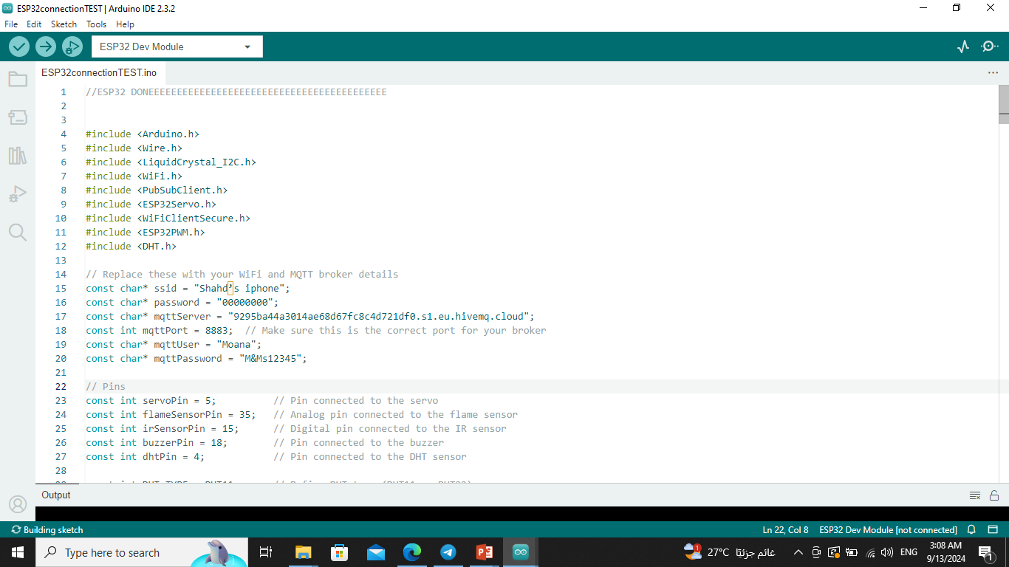
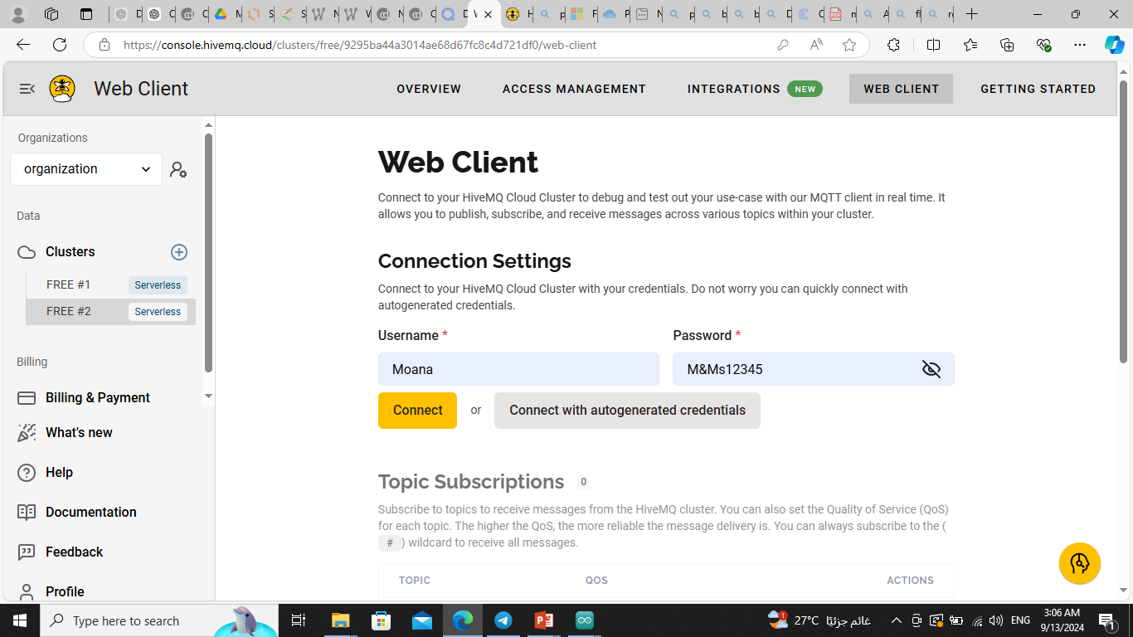

Slide 21
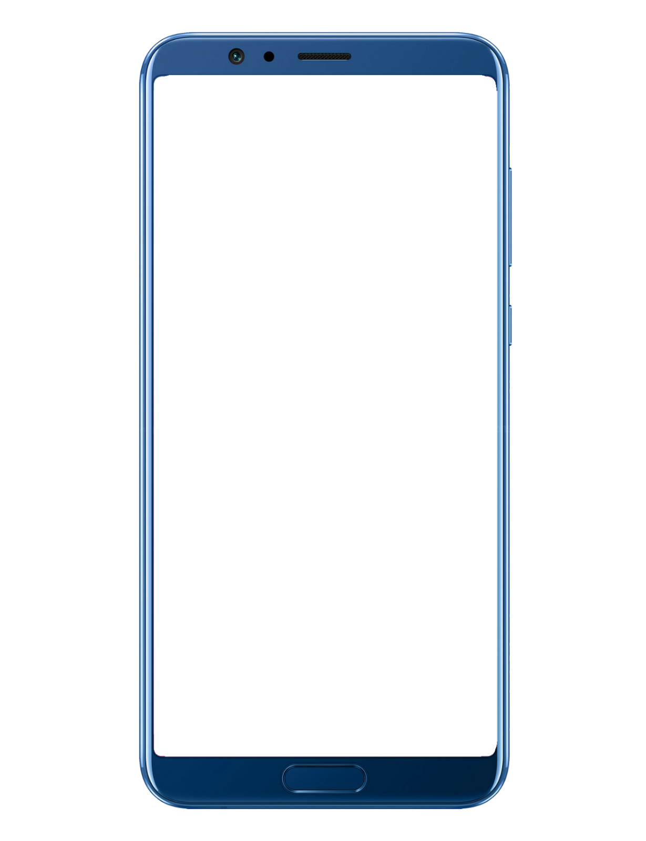
MQTT Broker
Data Flow
ARDUINO UNO
ESP32

Slide 22
The ESP32 publishes sensor data to specific topics
flame/detected
sensor/reading
ultrasonic/distance,
temp/reading,
humidity/reading
The MQTT subscribes to a specific topic to control the status of LED
led/control
The MQTT broker forwards data to the Flutter app subscribed to the relevant topics.

Slide 23
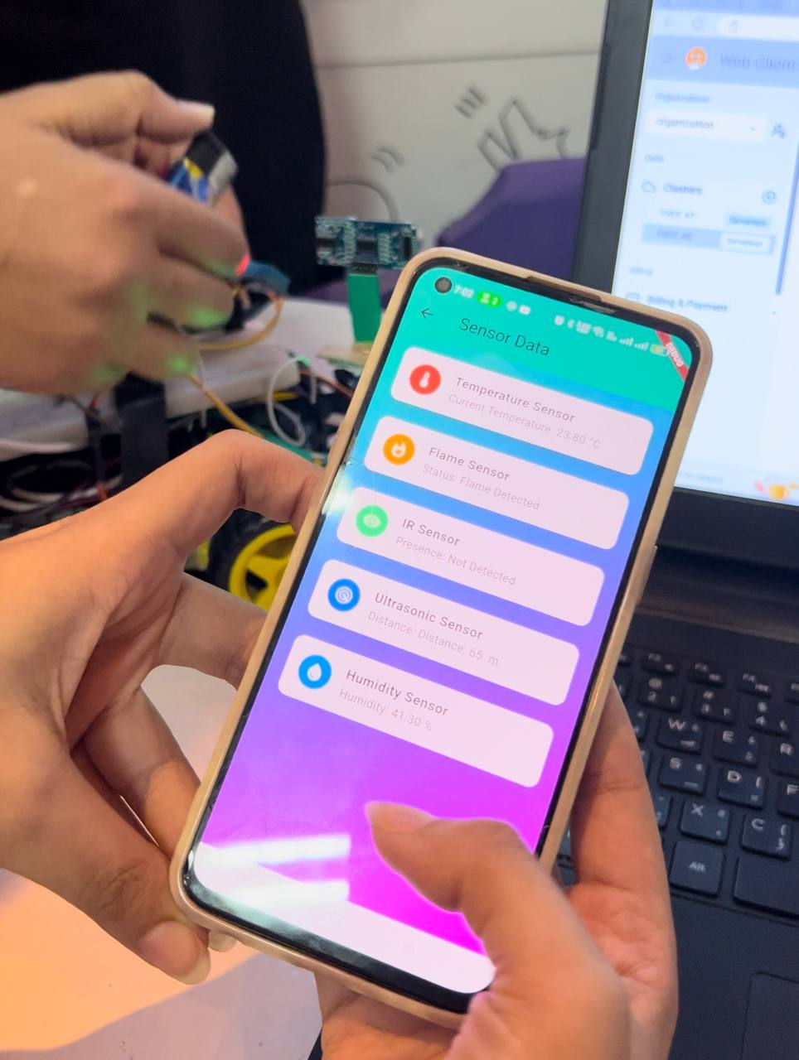
Flutter Application Interface

Slide 24
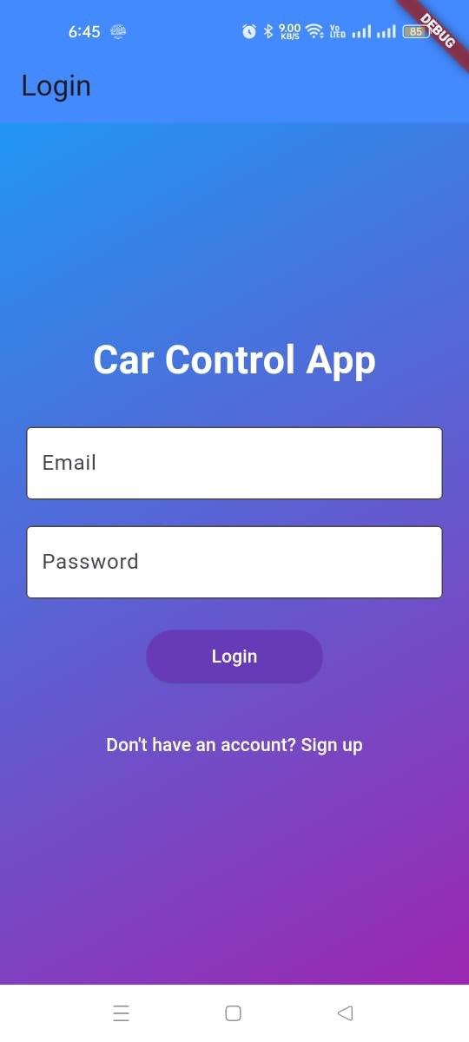
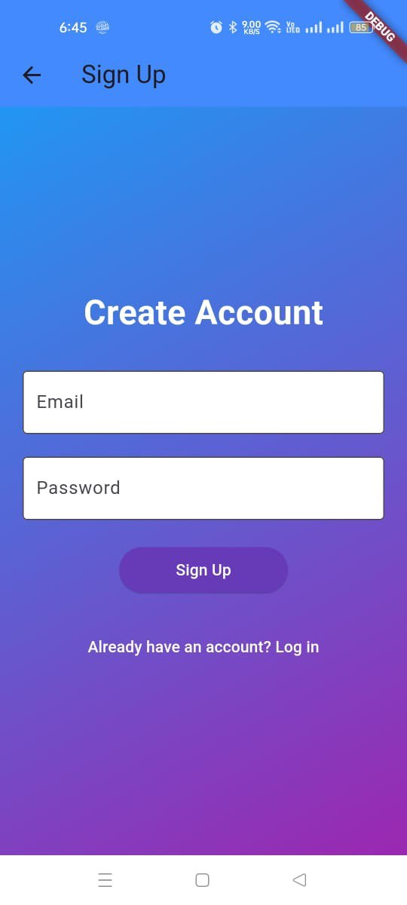

Slide 25
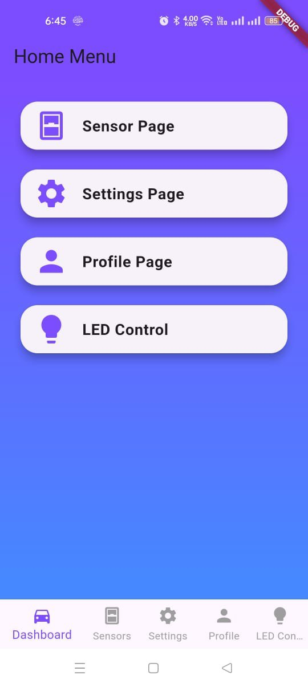

Slide 26
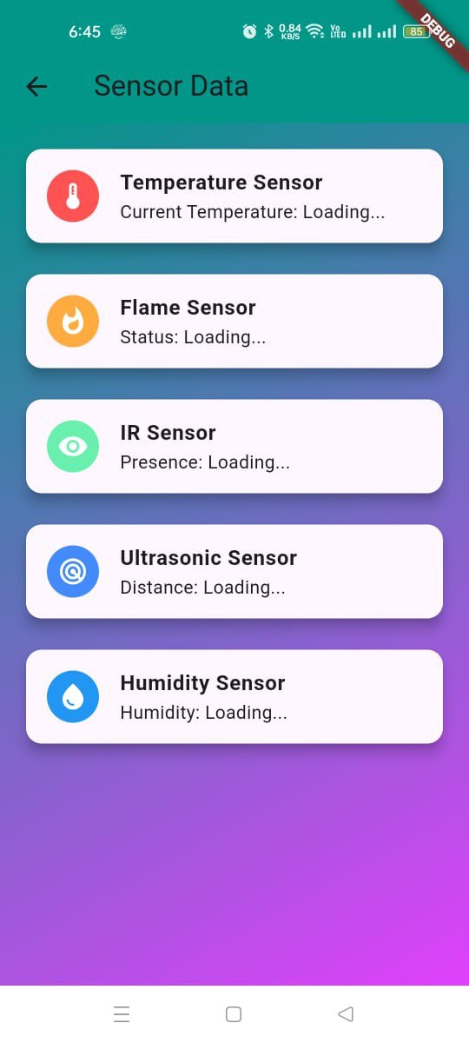

Slide 27
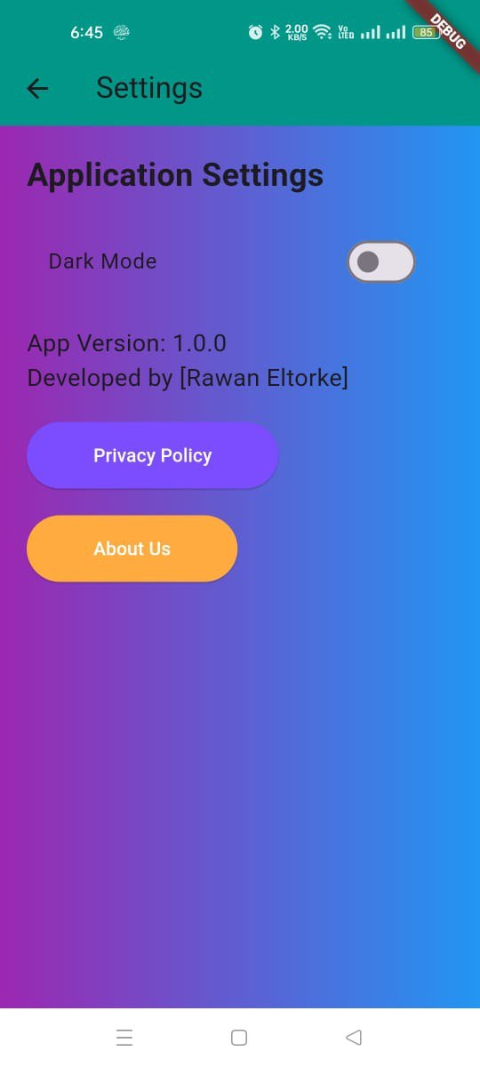
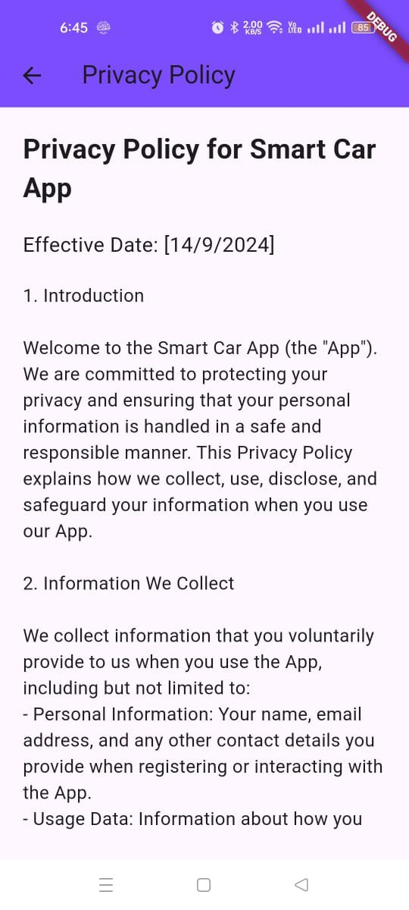
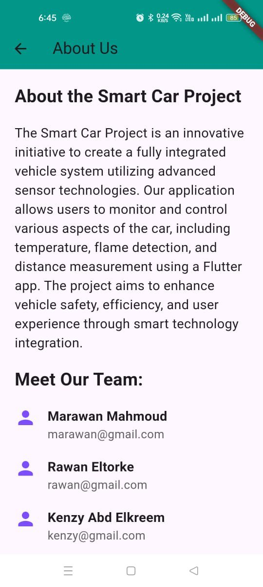

Slide 28
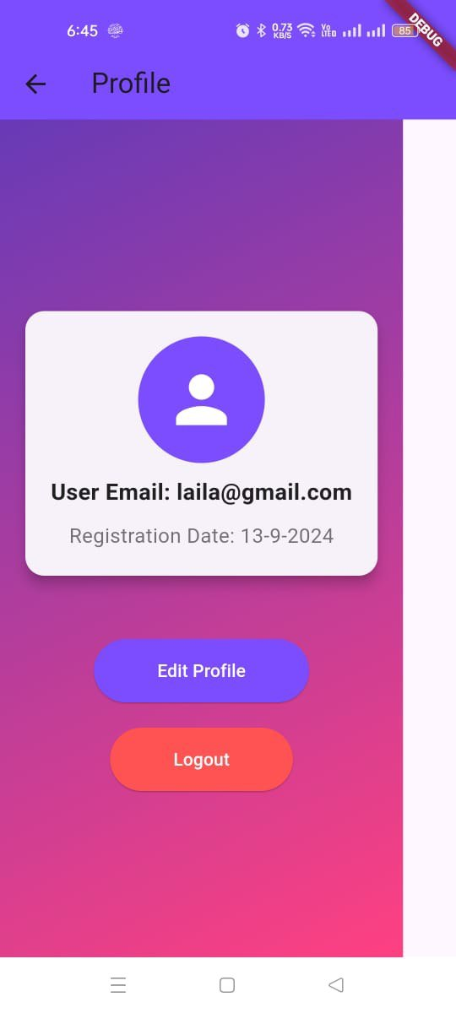
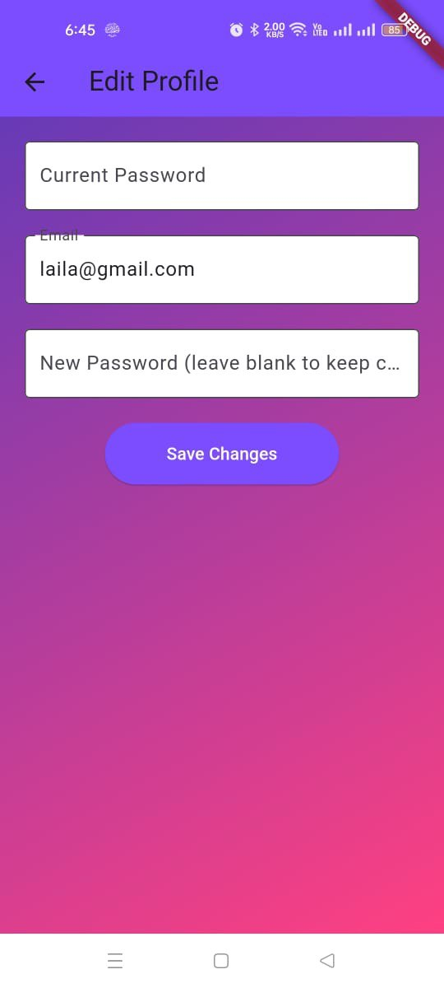

Slide 29
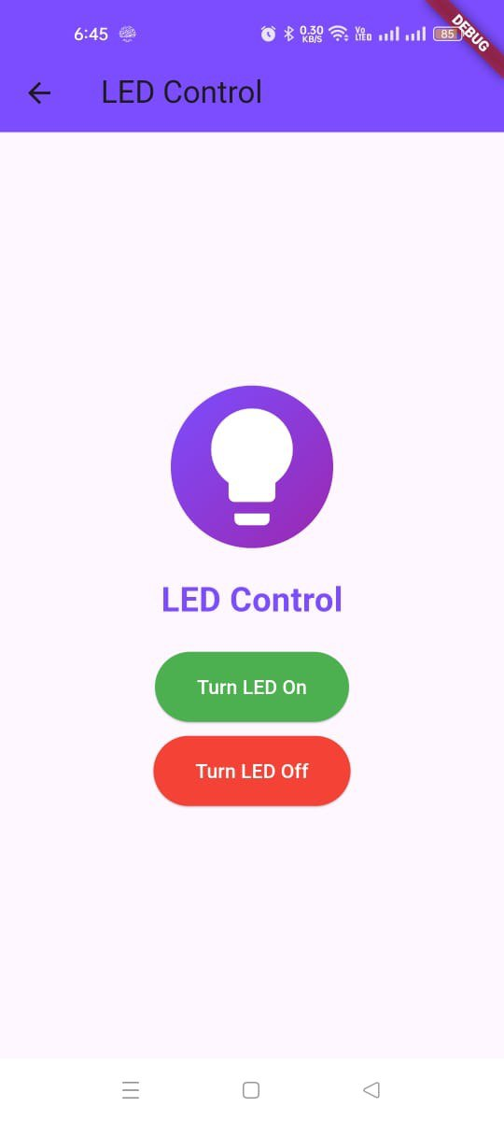

Slide 30
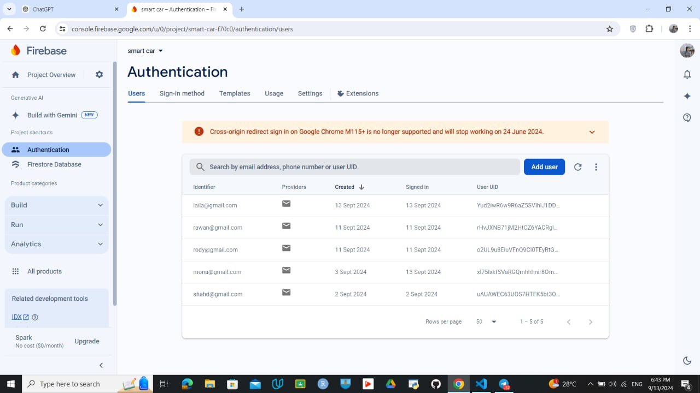

Slide 31
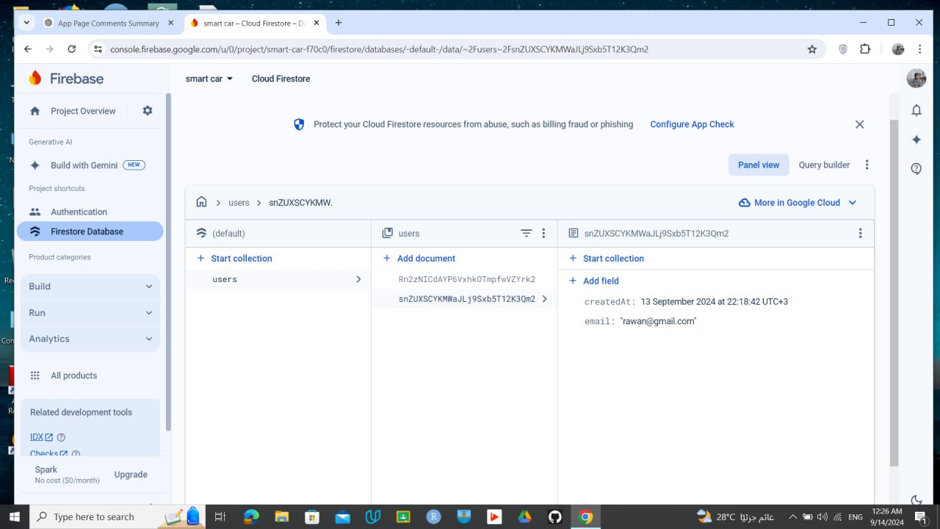

Slide 32
References
HiveMQ MQTT Broker Documentation
Firebase Documentation
Getting started with ESP32 development board –Random Nerds
Lucidchart platform for Schema bloc

Slide 33
Acknowledgment
We would like to express our sincere gratitude to our trainers for their valuable guidance and continuous support throughout this project. Your expertise and encouragement have been instrumental in our learning and development.
A special thanks to Eng. Mahmoud for always being available, providing constant support, and helping us overcome challenges with his friendly approach and invaluable assistance in our tasks.

Slide 34
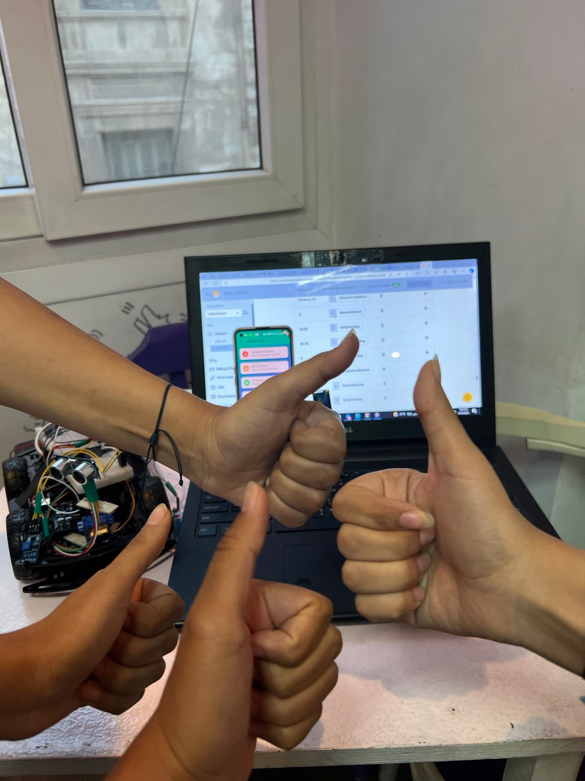
THANK YOU

